Slide 1


<Name>
<Date>

Slide 2

Outline
Executive Summary
Introduction
Methodology
Results
Conclusion
Appendix

Slide 3
Executive Summary
Summary of methodologies
Summary of all results

Slide 4
Introduction
Project background and context
Problems you want to find answers

Slide 5

Section 1

Slide 6
Methodology
Executive Summary
Data collection methodology:
Describe how data was collected
Perform data wrangling
Describe how data was processed
Perform exploratory data analysis (EDA) using visualization and SQL
Perform interactive visual analytics using Folium and Plotly Dash
Perform predictive analysis using classification models
How to build, tune, evaluate classification models

Slide 7
Data Collection
Describe how data sets were collected.
Request and parse the SpaceX launch data using the GET request
Decode the response content as a Json using .json() and turn it into a Pandas data frame using .json_normalize()
Filter the data frame only to include Falcon 9 launches
Dealing with Missing Values
Export it to a CSV for the next section, but to make the answers consistent, we will provide data in a pre-selected date range in the next lab.
data_falcon9.to_csv('dataset_part_1.csv', index=False)

Slide 8
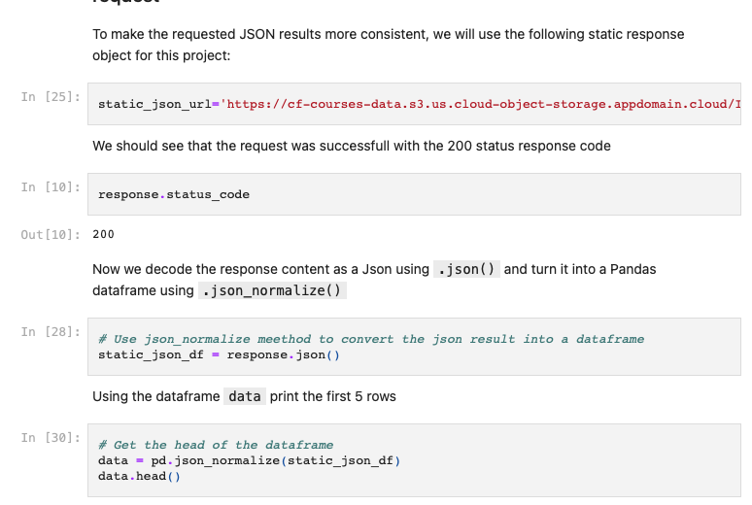
Data Collection – SpaceX API
During this process, we use an HTTP GET request to retrieve SpaceX launch data from its API. For easier analysis, we then parse this JSON data into a structured format, such as a Python dictionary or a pandas data frame. A static response object is used for consistent results.
https://github.com/kingfroglao/Coursera_IBM-Data-Science/blob/main/Applied%20Data%20Science%20Capstone/Data%20Collection%20API%20Lab.ipynb
Place your flowchart of SpaceX API calls here

Slide 9
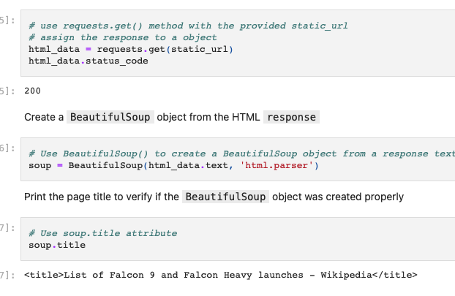
Data Collection - Scraping
In this step, we send an HTTP GET request to the URL of the Falcon9 Launch Wiki page, which results in an HTTP response containing the HTML content of the requested page.
https://github.com/kingfroglao/Coursera_IBM-Data-Science/blob/main/Applied%20Data%20Science%20Capstone/Data%20Collection%20with%20Web%20Scraping%20lab.ipynb
Place your flowchart of web scraping here

Slide 10
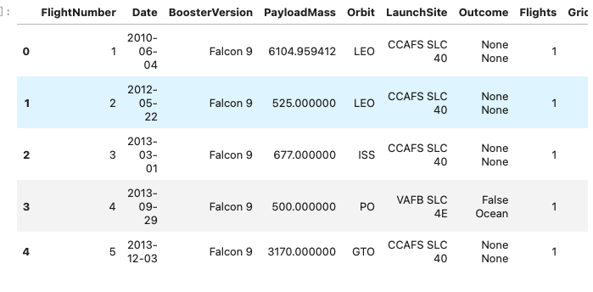
Data Wrangling
1: Calculate the number of launches on each site
2: Calculate the number and occurrence of each orbit
3: Calculate the number and occurence of mission outcome per orbit type
4: Create a landing outcome label from Outcome column
https://github.com/kingfroglao/Coursera_IBM-Data-Science/blob/main/Applied%20Data%20Science%20Capstone/Data%20wrangling.ipynb

Slide 11
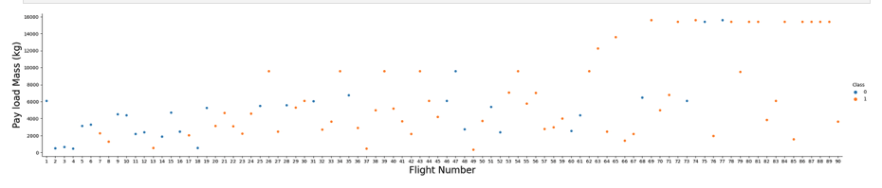
EDA with Data Visualization
The scatter plot was used to visualize the relationship between the 'FlightNumber' (representing sequential launch attempts) and 'PayloadMass', overlaid with the outcome of each launch. This plot allowed us to infer that with increasing flight numbers and decreasing payload mass, the likelihood of successful first stage landing seems to increase.
The bar chart was then utilized to show the success rate of each orbit type. This helped us understand the variance in success rate among different orbits, offering insights into which orbits have higher probabilities of successful launches. Both of these charts were instrumental in visualizing key aspects of the launch data and interpreting the factors contributing to launch success.
https://github.com/kingfroglao/Coursera_IBM-Data-Science/blob/main/Applied%20Data%20Science%20Capstone/EDA%20with%20Data%20Visualization.ipynb

Slide 12
EDA with SQL
Retrieved unique launch site names.
Displayed 5 records of launch sites starting with 'CCA’.
Calculated total payload mass for NASA's CRS launches.
Found average payload mass for booster version F9 v1.1.
Determined date of first successful ground pad landing.
Listed boosters are successful in drone ship landings with payload mass between 4000-6000.
Calculated total successful and failed mission outcomes.Identified booster versions carrying the maximum payload mass.
Displayed records with month, failure landing outcomes in drone ships, booster versions, and launch sites for 2015.
Ranked landing outcomes between 2010-06-04 and 2017-03-20 in descending order.
https://github.com/kingfroglao/Coursera_IBM-Data-Science/blob/main/Applied%20Data%20Science%20Capstone/EDA%20with%20SQL.ipynb

Slide 13
Build an Interactive Map with Folium
We added annotations to all launch sites on a folium map, integrating various map elements to represent the success or failure of launches at each location. The 'launch outcomes' were assigned to two classes, 0 for failure and 1 for success, which helped us to distinguish launch sites with relatively high success rates using color-coded marker clusters. Furthermore, we calculated the proximity of each launch site to its surrounding features, investigating their proximity to railways, highways, or coastlines, and their distance from cities.
https://github.com/kingfroglao/Coursera_IBM-Data-Science/blob/main/Applied%20Data%20Science%20Capstone/Interactive%20Visual%20Analytics%20with%20Folium.ipynb

Slide 14
Build a Dashboard with Plotly Dash
We developed an interactive dashboard using Plotly Dash, providing a comprehensive view of SpaceX launch data.
Pie charts were constructed to depict the total number of launches from specific sites, providing a visual breakdown of launch distribution.
We created scatter plots to illustrate the relationship between the launch outcomes and payload mass (Kg) for various booster versions. These plots offer valuable insights into how these two parameters interact.

Slide 15
Predictive Analysis (Classification)
We initiated the process by loading the data through Numpy and Pandas, then proceeded with data transformation, followed by a split into training and testing sets. With this prepared data, we constructed various machine learning models and fine-tuned their hyperparameters utilizing GridSearchCV.
Accuracy served as our key evaluation metric throughout the modeling process. To enhance the performance of our models, we employed feature engineering techniques and refined our algorithm parameters.
Upon completion of these iterative processes, we successfully identified the best-performing classification model for our dataset.
https://github.com/kingfroglao/Coursera_IBM-Data-Science/blob/main/Applied%20Data%20Science%20Capstone/%20Machine%20Learning%20Prediction%20lab.ipynb

Slide 16
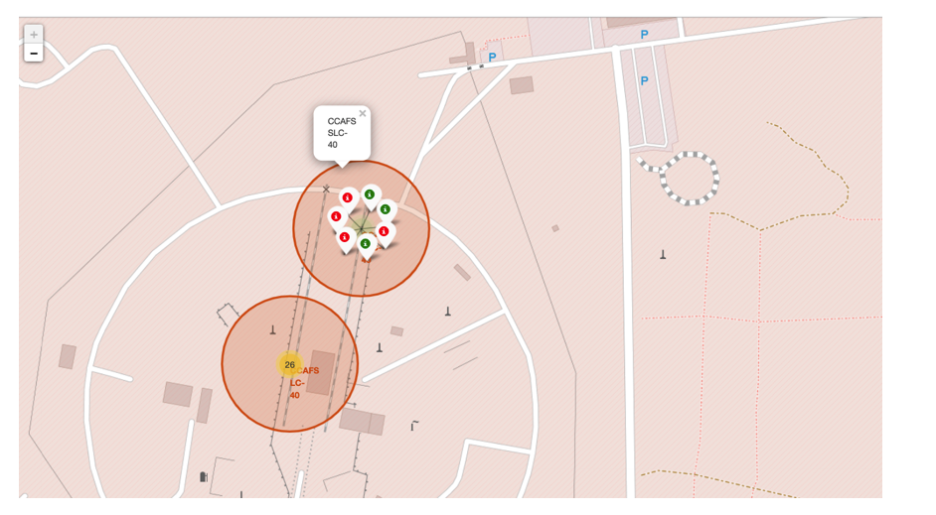
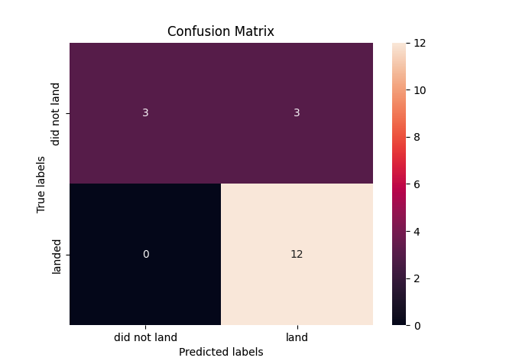
Results
Exploratory data analysis results
Interactive analytics demo in screenshots
Predictive analysis results

Slide 17

Section 2

Slide 18
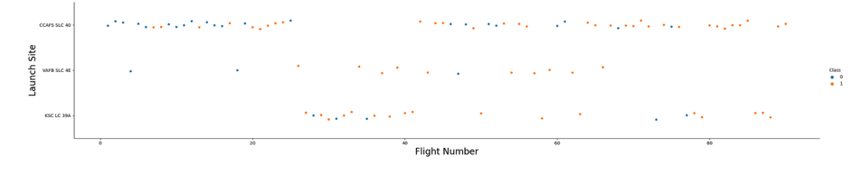
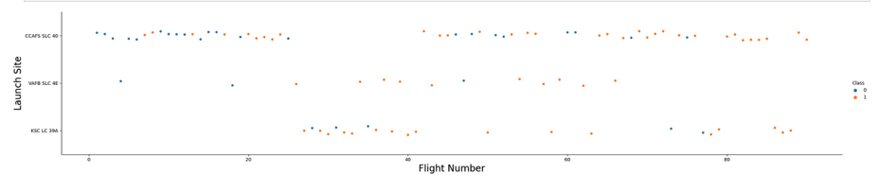
Flight Number vs. Launch Site
From the visual representation, it is evident that a launch site's success rate is positively correlated with its flight volume - the higher the number of flights a launch site conducts, the greater its success rate.

Slide 19
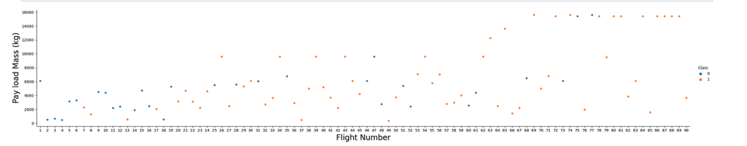
Payload vs. Launch Site
Show a scatter plot of Payload vs. Launch Site
We see that different launch sites have different success rates. CCAFS LC-40, has a success rate of 60 %, while KSC LC-39A and VAFB SLC 4E has a success rate of 77%.

Slide 20

Success Rate vs. Orbit Type
From the visualization, it is evident that the orbits ES-L1, GEO, HEO, SSO, and VLEO have achieved the highest success rates.

Slide 21
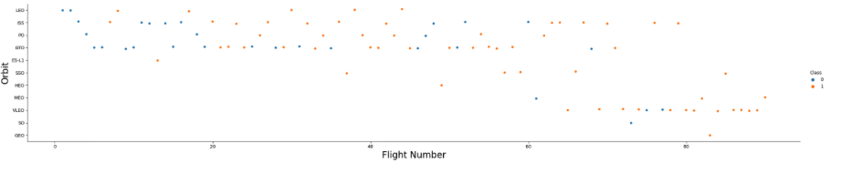
Flight Number vs. Orbit Type
Show a scatter point of payload vs. orbit type
Show t
The following graph illustrates the relationship between Flight Number and Orbit type. It's noticeable that for flights within the Low Earth Orbit (LEO), the success rate seems to correlate with the number of flights. However, for those in the Geosynchronous Transfer Orbit (GTO), no such correlation between the flight number and success rate is evident.

Slide 22
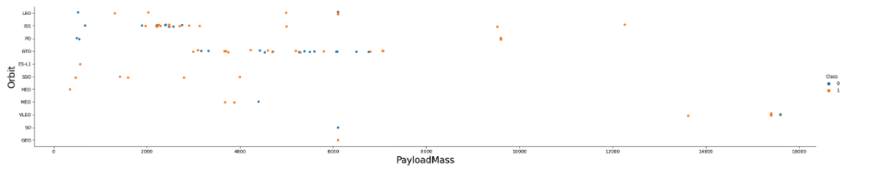
Payload vs. Orbit Type
Show a scatter point of Flight number vs. Orbit type
Show the scree
With heavy payloads the successful landing or positive landing rate are more for Polar,LEO and ISS.

Slide 23
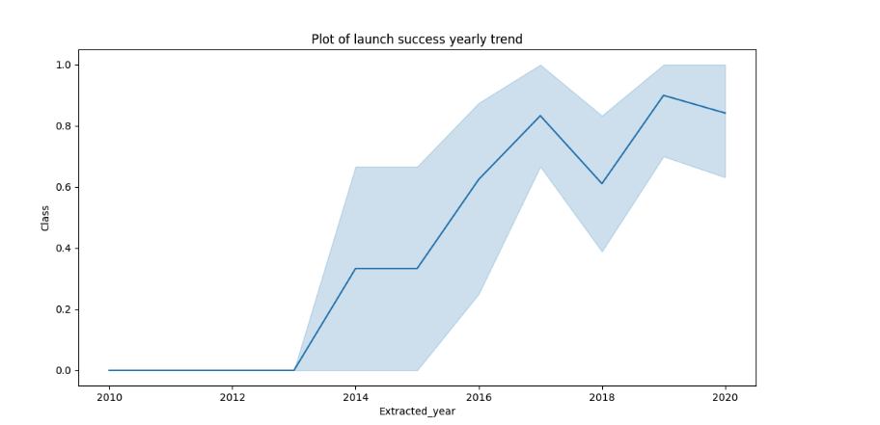
Launch Success Yearly Trend
Based on the plot, it is evident that the success rate has consistently risen since 2013, up until 2020.

Slide 24
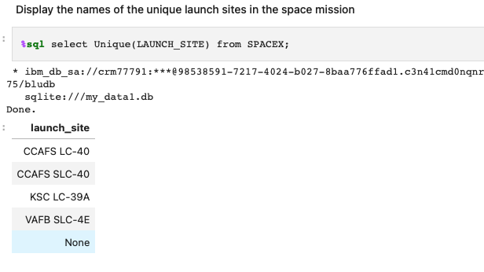
All Launch Site Names
Find the names of the unique launch sites
Present your query result with a short explanation here

Slide 25
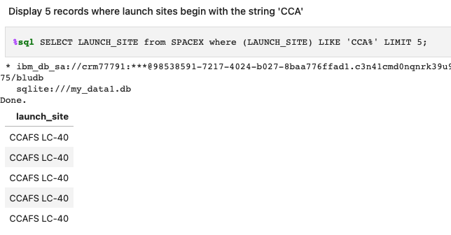
Launch Site Names Begin with 'CCA'
We used the query above to display 5 records where launch sites begin with `CCA`

Slide 26
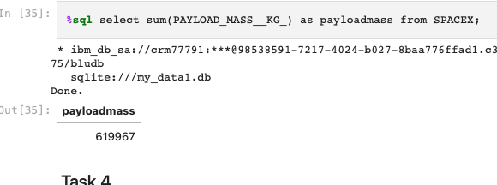
Total Payload Mass
Display the total payload mass carried by boosters launched by NASA (CRS)

Slide 27
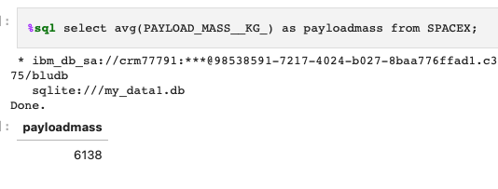
Average Payload Mass by F9 v1.1
Display average payload mass carried by booster version F9 v1.1

Slide 28
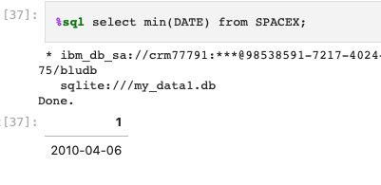
First Successful Ground Landing Date
Use min function to list the date when the first succesful landing outcome in ground pad was acheived.

Slide 29
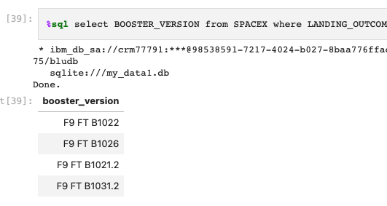
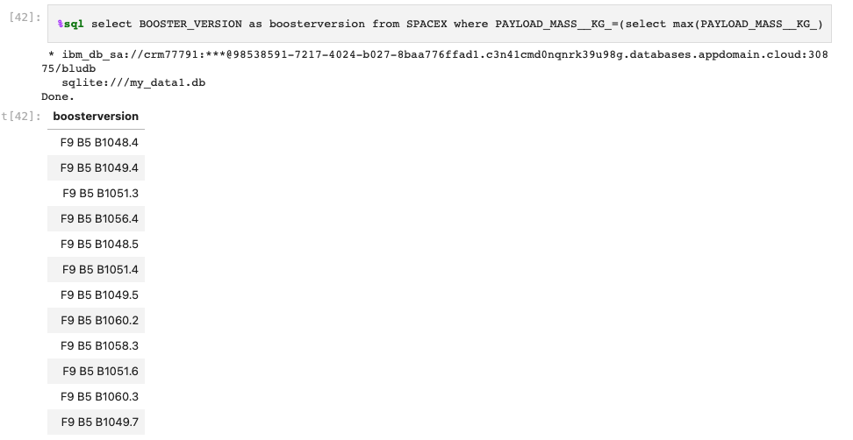
Successful Drone Ship Landing with Payload between 4000 and 6000
The modified SQL query retrieves the names of boosters that have successfully landed on a drone ship and had a payload mass greater than 4000kg but less than 6000kg.

Slide 30
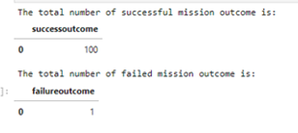
Total Number of Successful and Failure Mission Outcomes
The SQL query lists the records showing the month names, failure landing outcomes on a drone ship, booster versions, and launch sites for the months in the year 2015, using the substr function to extract the month and year from the date column.

Slide 31
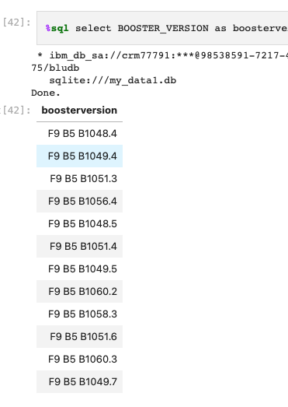
Boosters Carried Maximum Payload
We determined the booster that have carried the maximum payload using a subquery in the WHERE clause and the MAX() function.

Slide 32
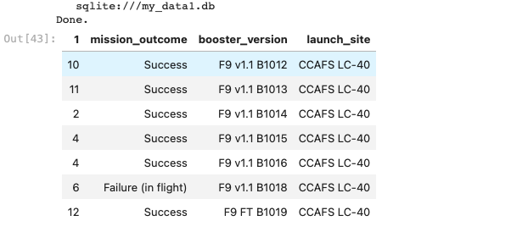
2015 Launch Records
We applied a combination of the WHERE clause, LIKE, AND, and BETWEEN conditions to filter the records for failed landing outcomes on a drone ship, corresponding booster versions, and launch site names specifically for the year 2015.

Slide 33
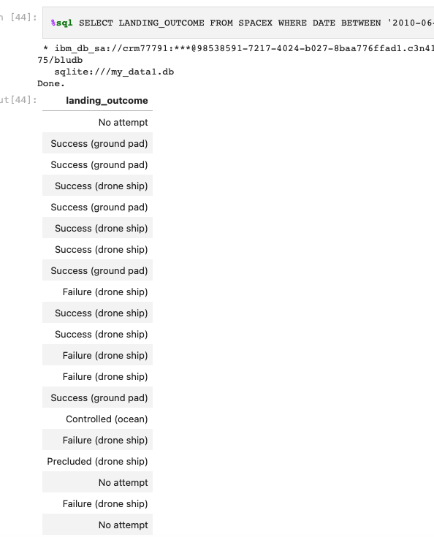
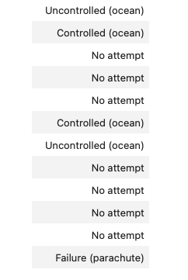
Rank Landing Outcomes Between 2010-06-04 and 2017-03-20
Select landing_outcome from spacex where date between '2010-06-04' and '2017-03-20' order by date desc;

Slide 34

Section 3

Slide 35
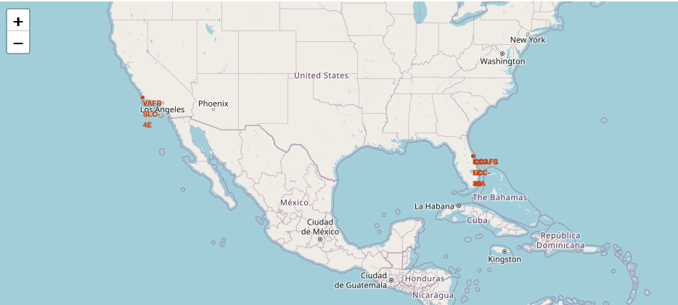
All launch sites global map markers
All launch sites are off the coast of the southern United States

Slide 36
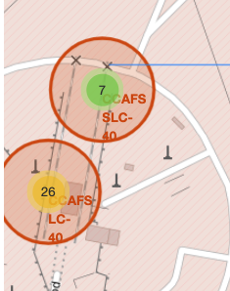
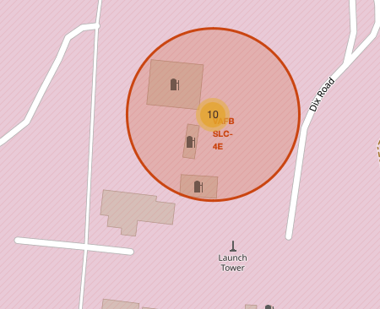
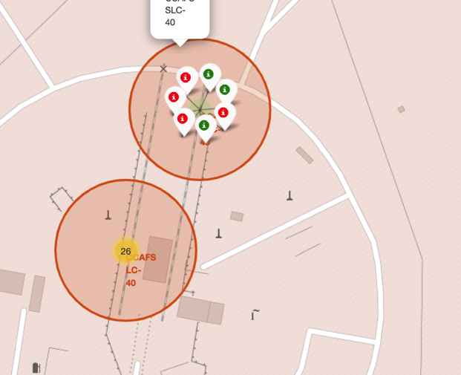
Color-labeled launch outcomes on the map
Green is success, red is failure

Slide 37
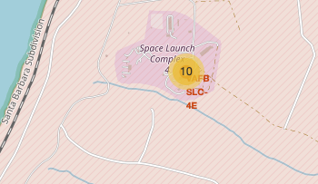
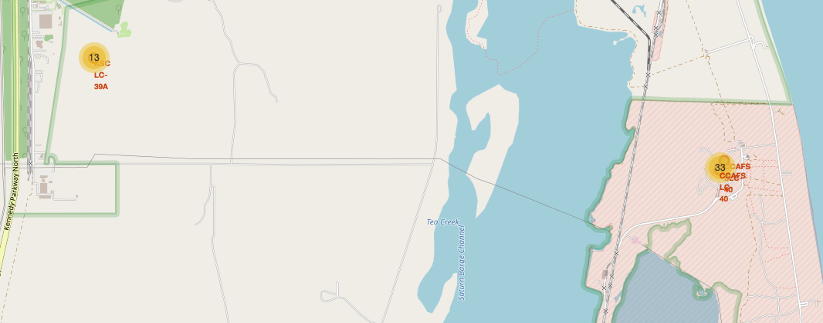
Launch Site distance to landmarks
Launch sites are not in close proximity to railways, they are not in close proximity to highways, they are in close proximity to the coastline, and they maintain a certain distance away from cities.

Slide 38

Section 4

Slide 39
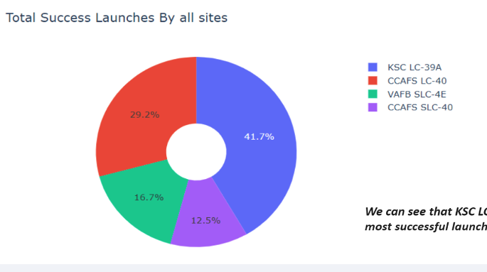

Piechart of launch success count for all sites
KSC LC-39A was the most successful launch.

Slide 40
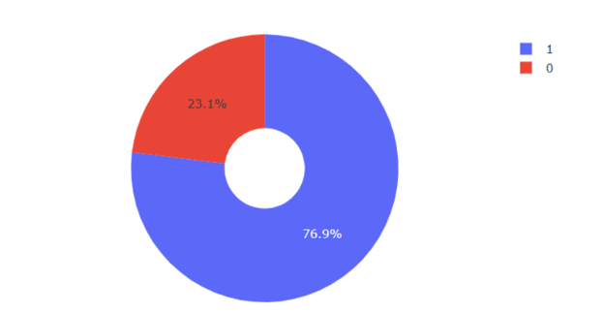
Piechart for the highest launch success ratio
KSC LC-39A had 76.9% success rate and 23.1% failure rate

Slide 41
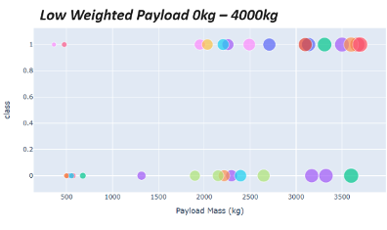
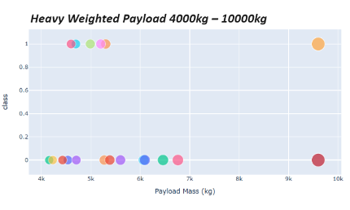
Payload vs. Launch
Low weigted payloads are more successful than high weighted payloads

Slide 42

Section 5

Slide 43
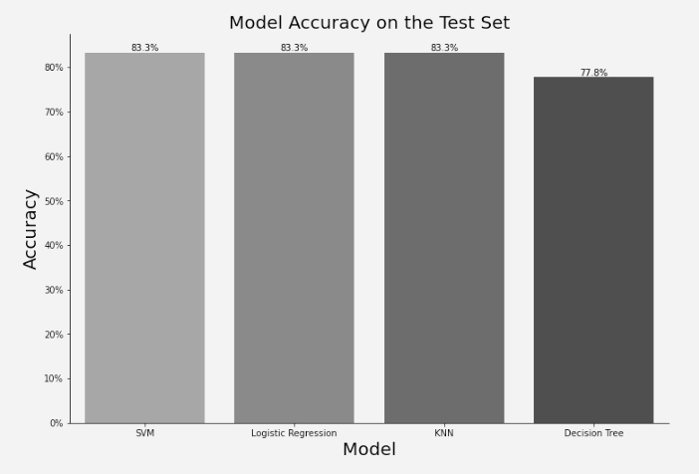
Classification Accuracy
The decision SVM, Logistic Regreesion and KNN are the model with the highest classification accuracy

Slide 44
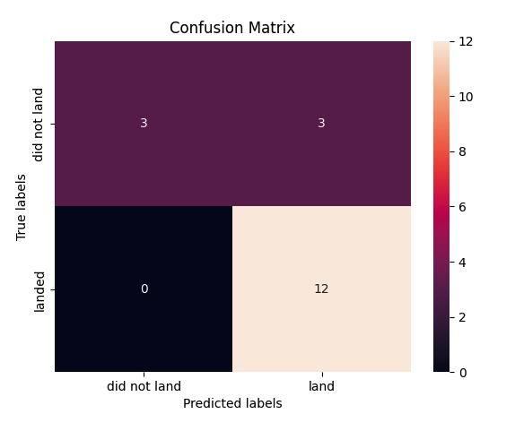
Confusion Matrix
The confusion matrix for a decision tree classifier reveals its ability to differentiate and classify different classes accurately.

Slide 45
Conclusions
Through the analysis, we obtained the following conclusions:
positive correlation between flight volume and success rate at the launch site, immediate flight volume exceeded, success rate exceeded.
During the period from 2013 to 2020, the rate of success has been steadily increasing.
Highest success rate for ES-L1, GEO, HEO, SSO and VLEO.
Among the existing launch sites, the KSC LC-39A has the highest launch success rate.
Finally, after comparing, we decided to present the best machine learning method for this task.

Slide 46


